Slide 1

Project Prediction Soccer Season 2022-2023
Franco Acerbi
12/04/2023

Slide 2
Introduction
We will use applied machine learning to explore Europe's top soccer leagues. Our goal is to uncover key factors defining success in these leagues by meticulously studying a broad range of variables. Through systematic statistical analysis, we aim to identify the critical elements to see which one is going to have the most effective one at the end of the season.

Slide 3


Metadata and Methodology
Metadata Overview:
Data Origin: Football Statistics and History | FBref.com
Timeframe: Captures data from last and current seasons, providing a comprehensive view of trends and patterns.
Variables: Includes but not limited to goals scored, possession, shots on target, passing accuracy, player injuries, team form, and historical performance.

Slide 4
Methodology:
Data Collection: Acquiring structured data from authenticated sources ensuring accuracy and reliability.
Install Required Libraries and Load Data
Preprocessing: Cleaning and organizing data
Feature Selection: Identifying relevant variables crucial for analysis.
Statistical Analysis: Utilizing regression, correlation, and machine learning techniques to determine the impact of variables on team success.
Model Validation: Employing cross-validation and other validation techniques to ensure the model's reliability and predictive capability.
Prediction: With a current new data we use the trained model to make predictions
Interpretation: Drawing conclusions based on statistical significance and practical implications of the findings.

Slide 5
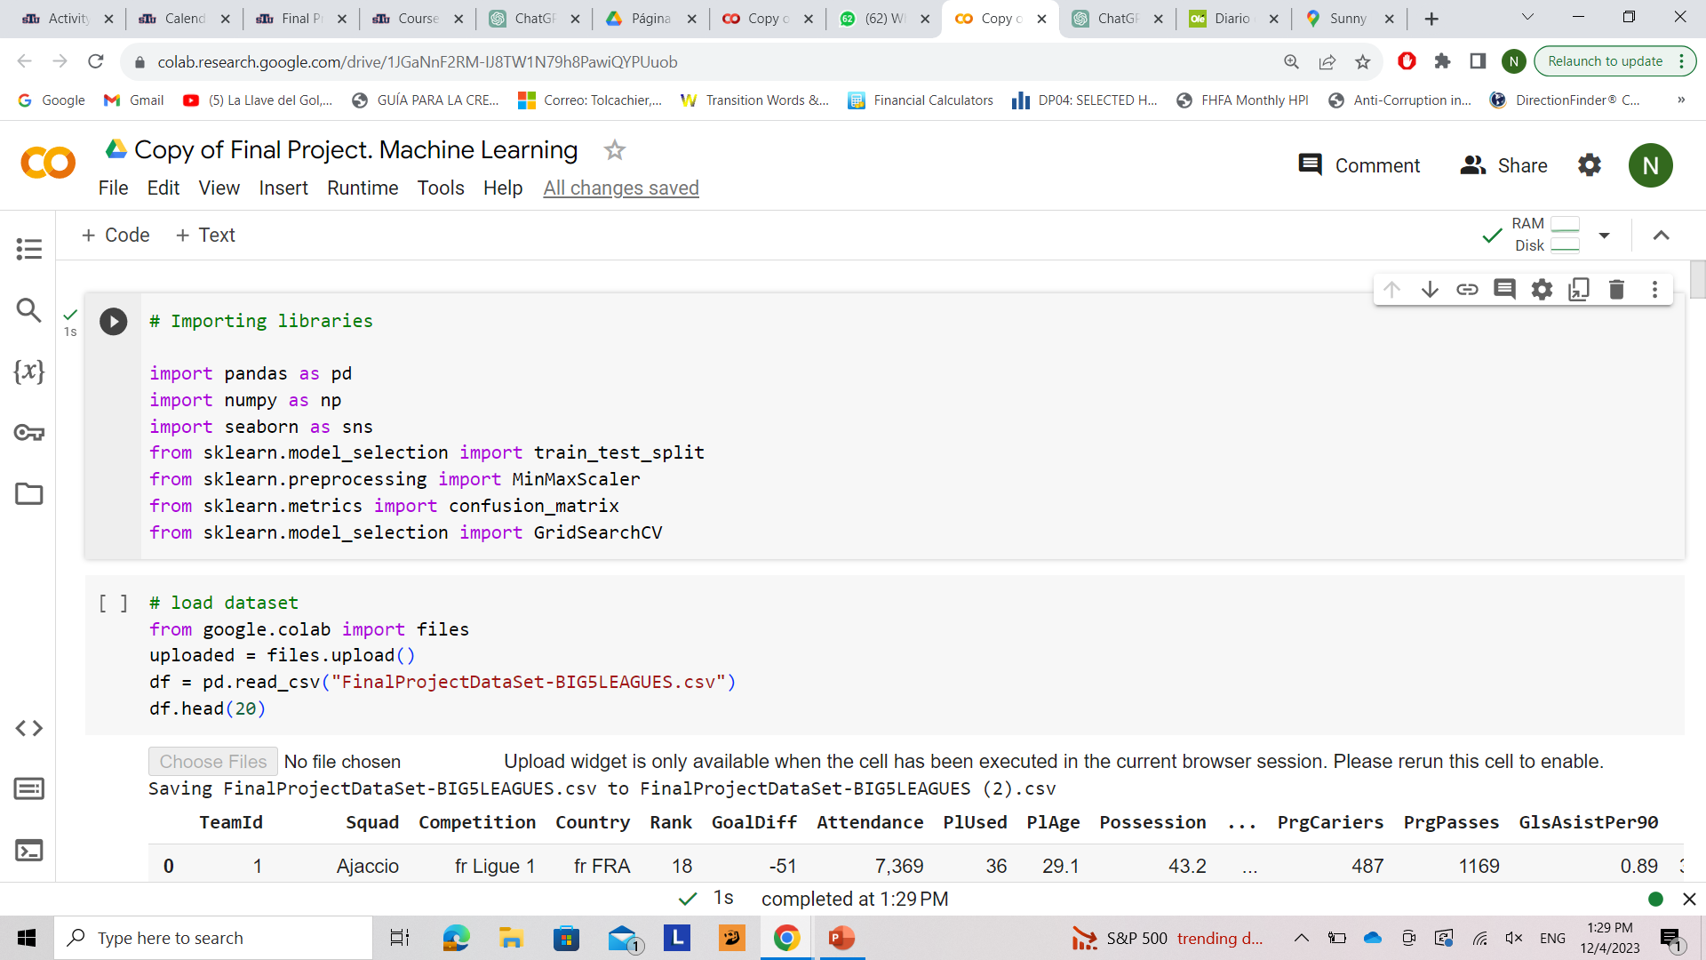
Collab

Slide 6
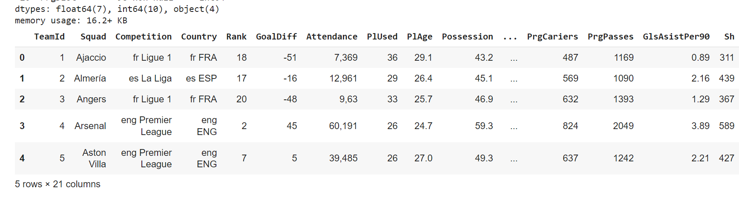
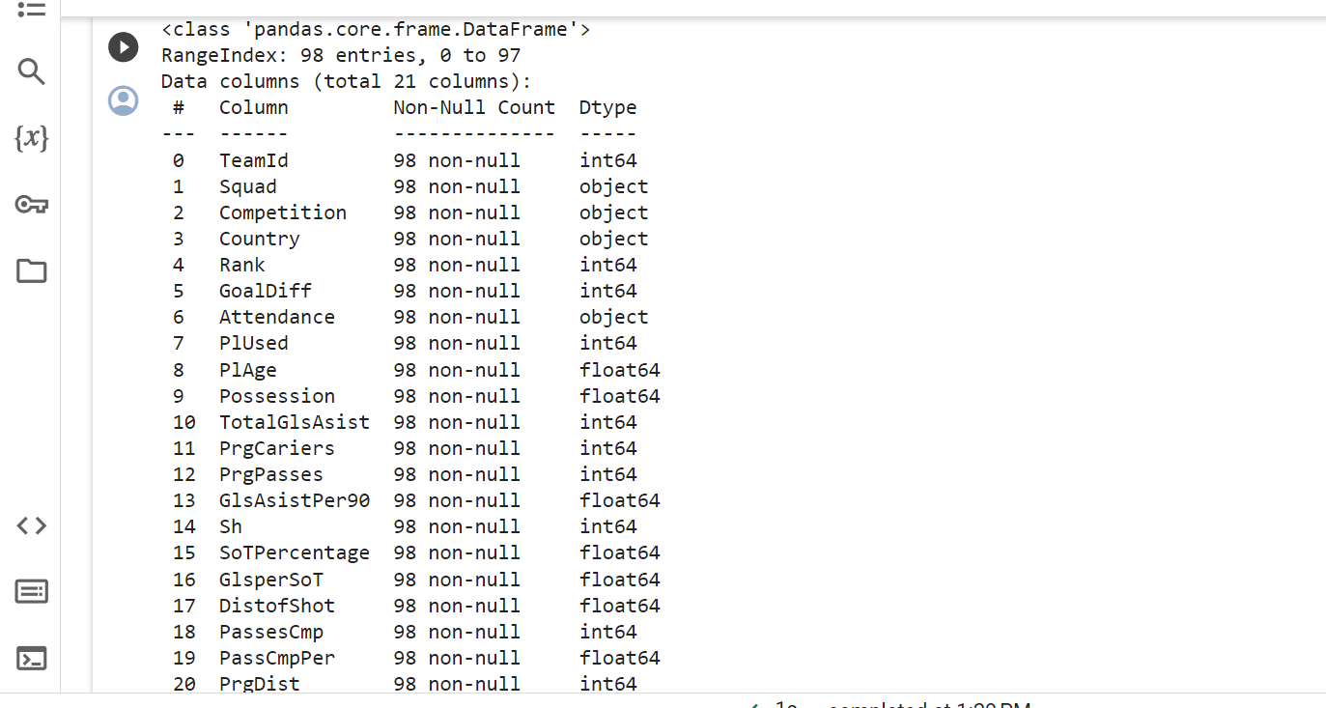
Summary of the data frame

Slide 7
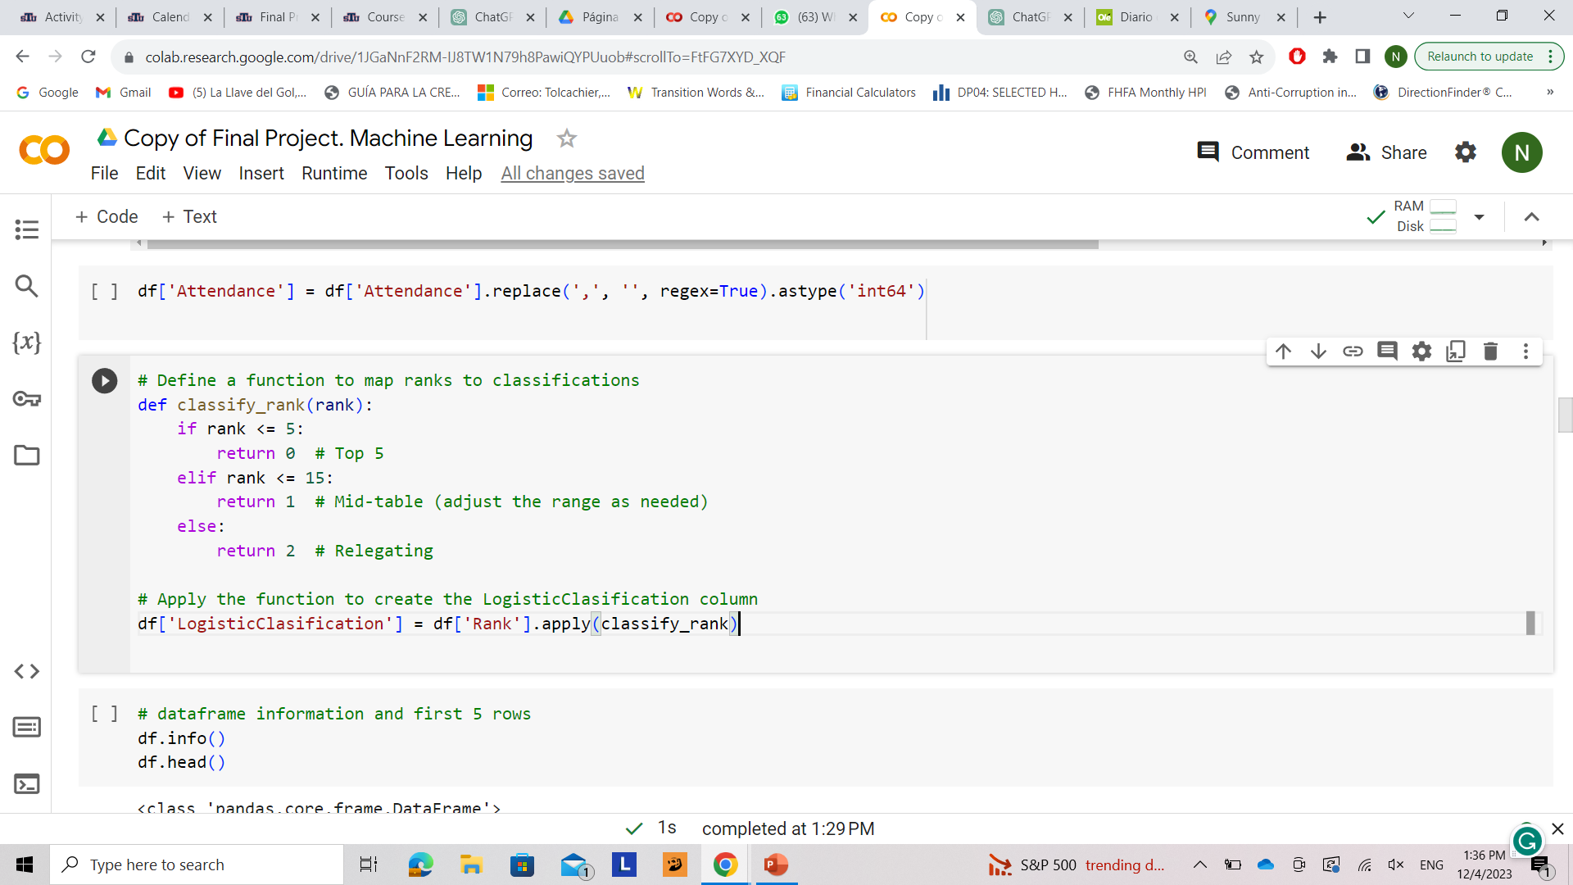
Classification: 0 TOP 5 1 MIDDLE TABLE 2 RELEGATION

Slide 8
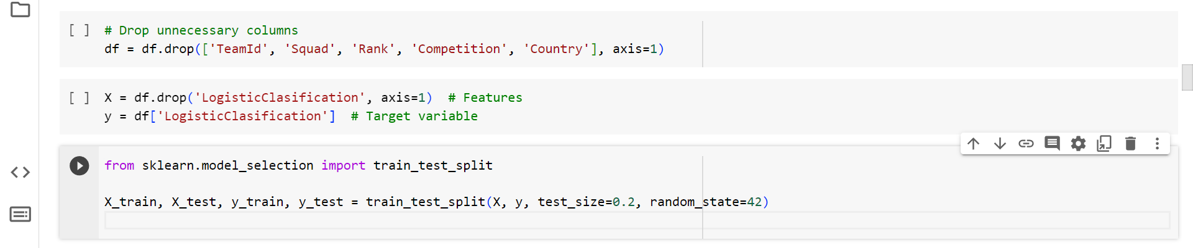
Test the data
Dropping unnecessary columns
Separating features and the target variable
Splitting the dataset into training and testing sets for machine learning model training and evaluation.

Slide 9
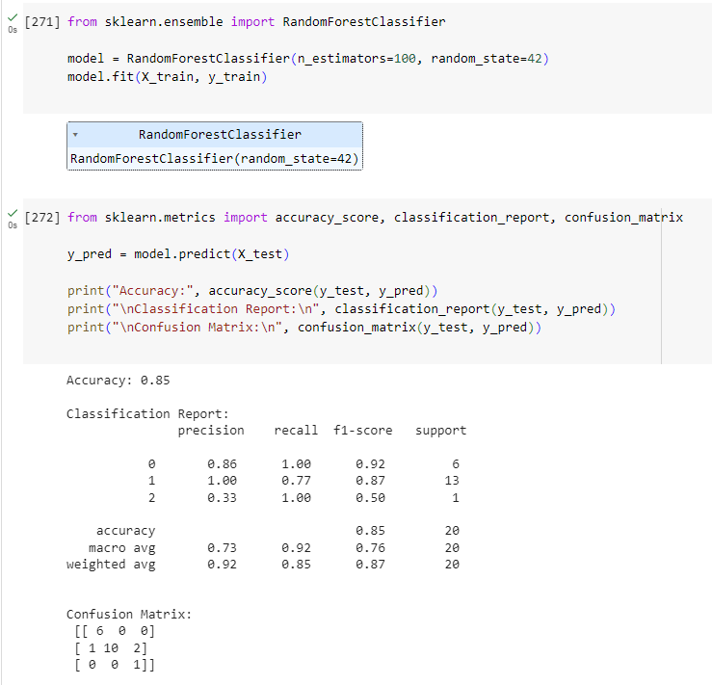
Predictive model
Accuracy, Classification Report and Matrix
High accuracy of an 85%.
The model performs well for classes 0, and 1 with high precision, recall, and F1-scores, indicating it's making accurate predictions for these classes.

Slide 10
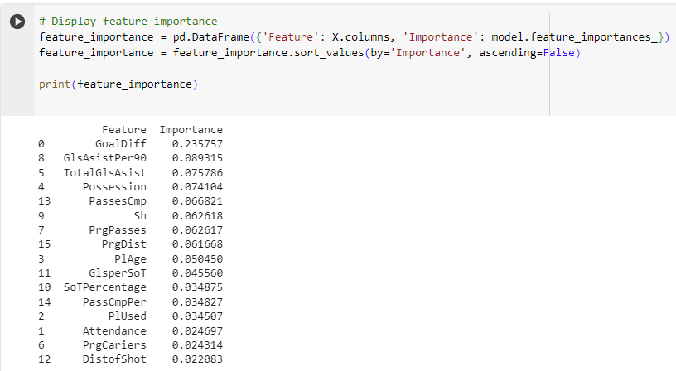
Feature Importance
Highlights:
Offensive Metrics: Goal-related metrics (GoalDiff, Shots, Assists) and metrics indicating attacking prowess (Progressive Passes, Possession, Completed Passes) seem to heavily influence the model. This suggests that offensive performance strongly correlates with the target variable.
Progressive Metrics: Metrics that denote progression in play, such as Progressive Passes and Progressive Distance, hold notable importance. This indicates the significance of advancing play in the team's success.
Player Age: While not the most critical, player age appears as a moderate influencer. This might suggest that the experience or youthfulness of the team has some impact on the outcome.

Slide 11
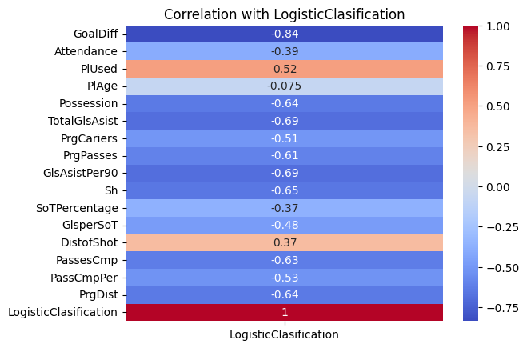
Logistic Classification
Strong Positive Correlation: Features with a high positive correlation (closer to 1.0) are represented by warmer colors. This indicates that as these features increase, the likelihood of the 'LogisticClasification' being a certain class also increases.
Strong Negative Correlation: Features with a high negative correlation (closer to -1.0) are represented by cooler colors. This suggests that as these features increase, the likelihood of 'LogisticClasification' being a certain class decreases.
Weak Correlation: Features with correlations closer to 0 indicate a weak linear relationship with the target variable. These correlations are represented by colors closer to white on the heatmap.

Slide 12
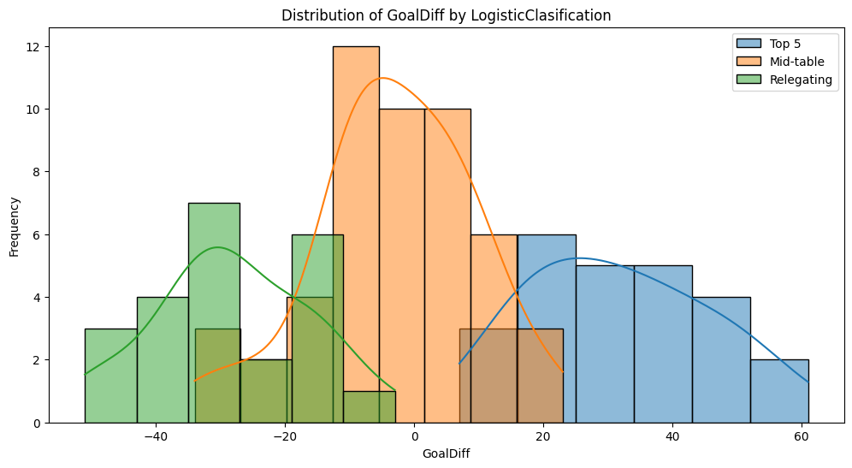
This graph represents the three different categories/classifications mentioned before and how Goal Difference is important in their rank.

Slide 13
Conclusions
Focus on Goal Difference: Teams with a positive goal difference tend to perform well. Emphasize offensive strategies to increase scoring while maintaining a strong defense to reduce conceding goals. Work on both scoring capabilities and defensive solidity to improve the goal difference.
Shots and Scoring Efficiency: Encourage the team to take more shots while ensuring these shots are on target. Analyze shot accuracy and work on improving conversion rates to increase the likelihood of scoring goals from shots taken.
Possession and Control: maintaining control of the ball can be crucial, as one of the most important metrics demonstrated before. Train the team to retain possession effectively, especially during critical phases of the game.

Slide 14
Future Prediction
Data Preprocessing:
You load a new dataset and clean it by converting certain columns to numeric values.
You calculate some ratios based on the number of games played for certain features.
Feature Selection:
You identify relevant features for your prediction model, like 'GoalDiff', 'Sh', 'GlsAsistPer90', etc.
Data Merging:
You merge the data from the past seasons with the current season's data.
Classification:
You define a function to classify teams into 'Top 5', 'Mid-table', or 'Relegating'.
You apply this function to create a new column, 'Winner', representing the classification.
Data Splitting:
You split the data into training and testing sets.
Model Training:
You convert specific columns to float and then proceed to train your model.
Model Evaluation:
You evaluate your model's accuracy on the test set.
Making Predictions:
You use the trained model to predict the current season's outcomes.
Result Presentation:
You display the predictions for the current season along with team names in a DataFrame.

Slide 15
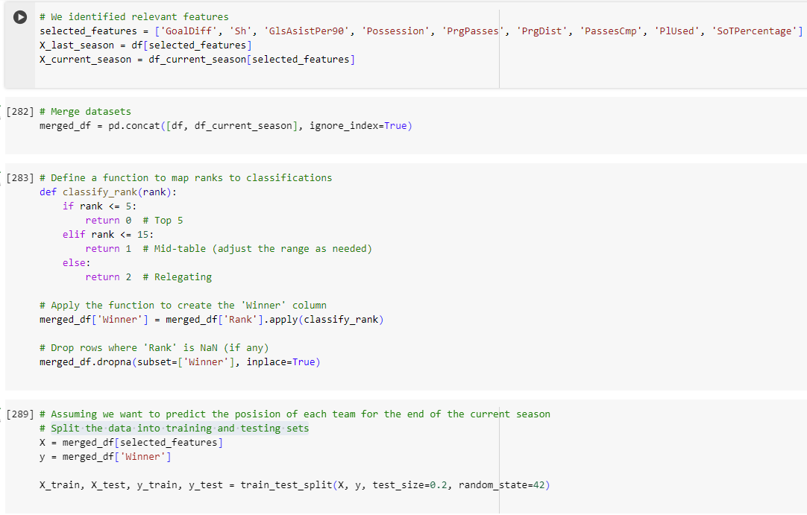
Identify relevant features
Merge DataSets
Split the data into training and testing

Slide 16
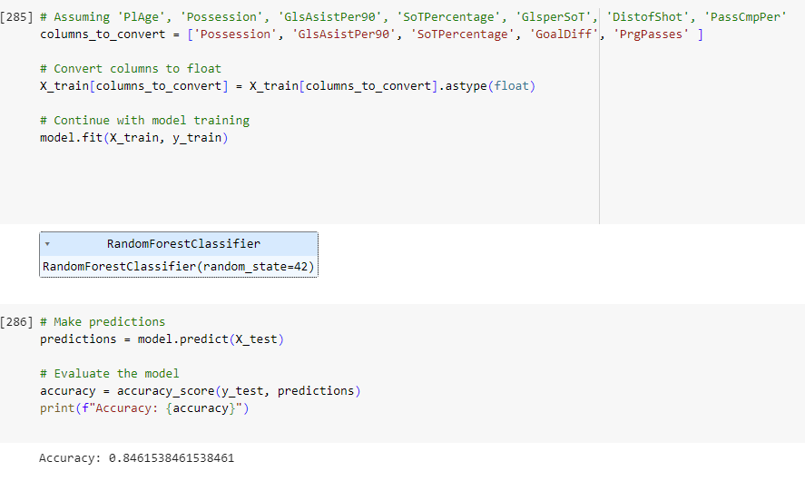
We train the Model
We use model.predict to create an accuracy score on prediction

Slide 17
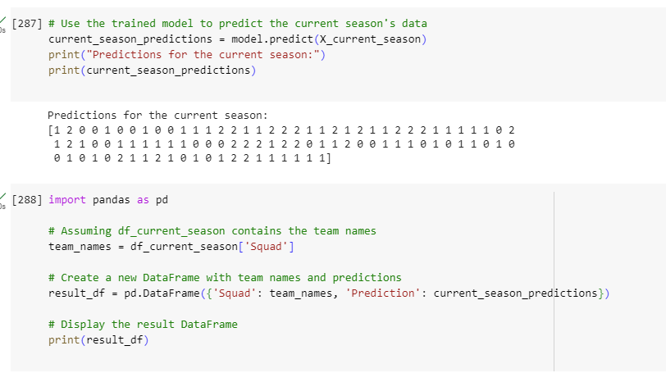
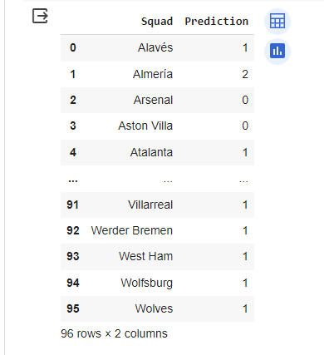
Prediction at the end of the season

Slide 18
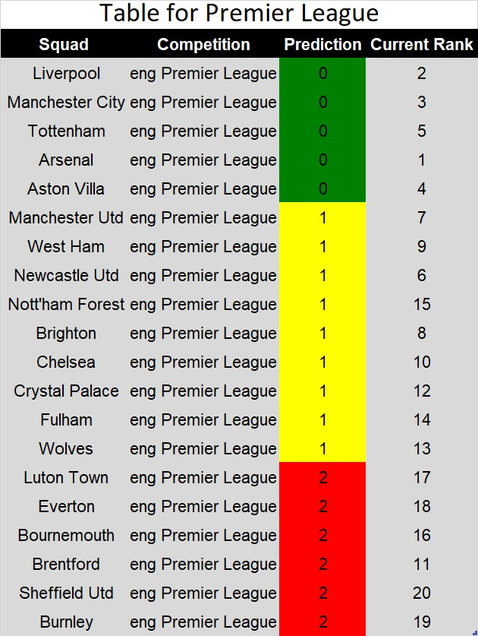
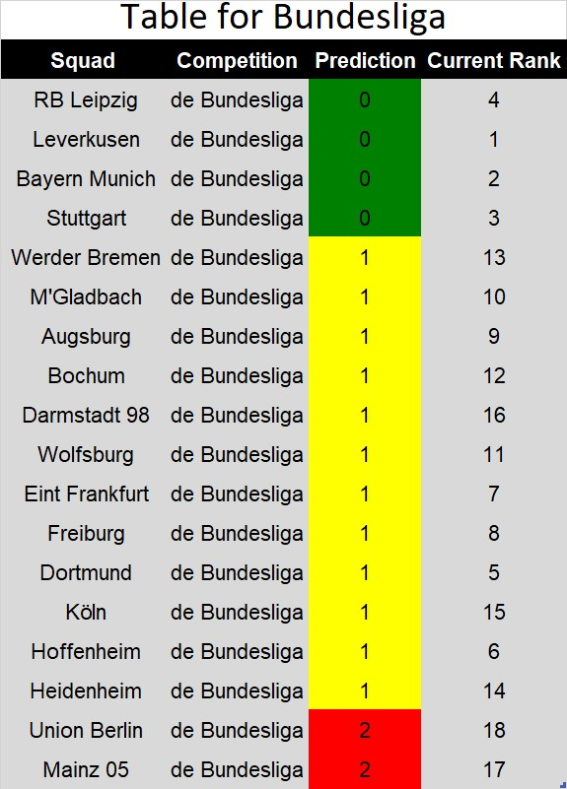
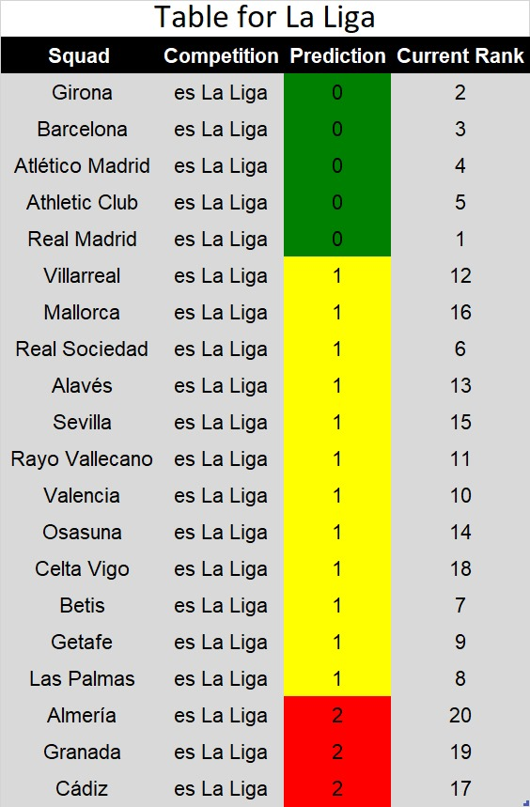
Predictions by the End of the Year

Slide 19
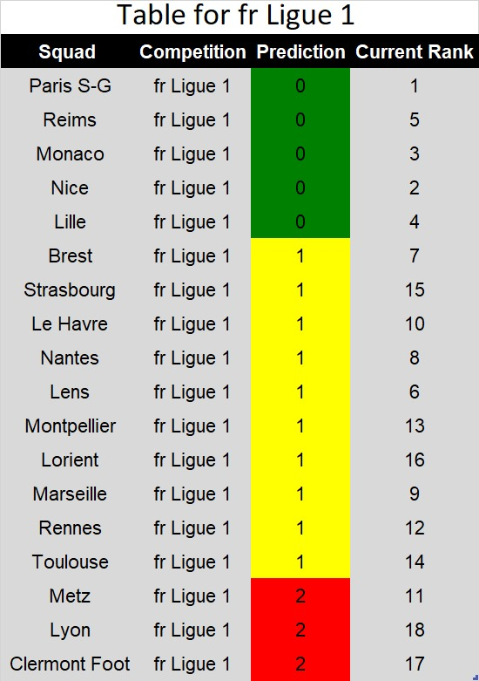
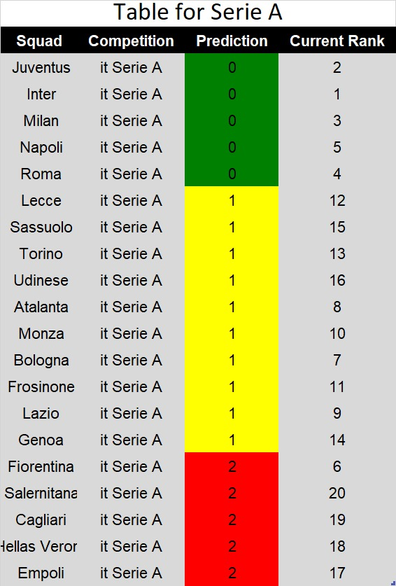
Predictions by the End of the Year

Slide 20
References
https://fbref.com/en/comps/Big5/Big-5-European-Leagues-Stats#all_big5_table

